Slide 1
Mise en œuvre de Pro Santé Connect avec Microsoft Entra ID
Atelier sur les stratégies d'accès conditionnelles à destination des établissements de santé
Version 1.0a – Mars 2025

Slide 2
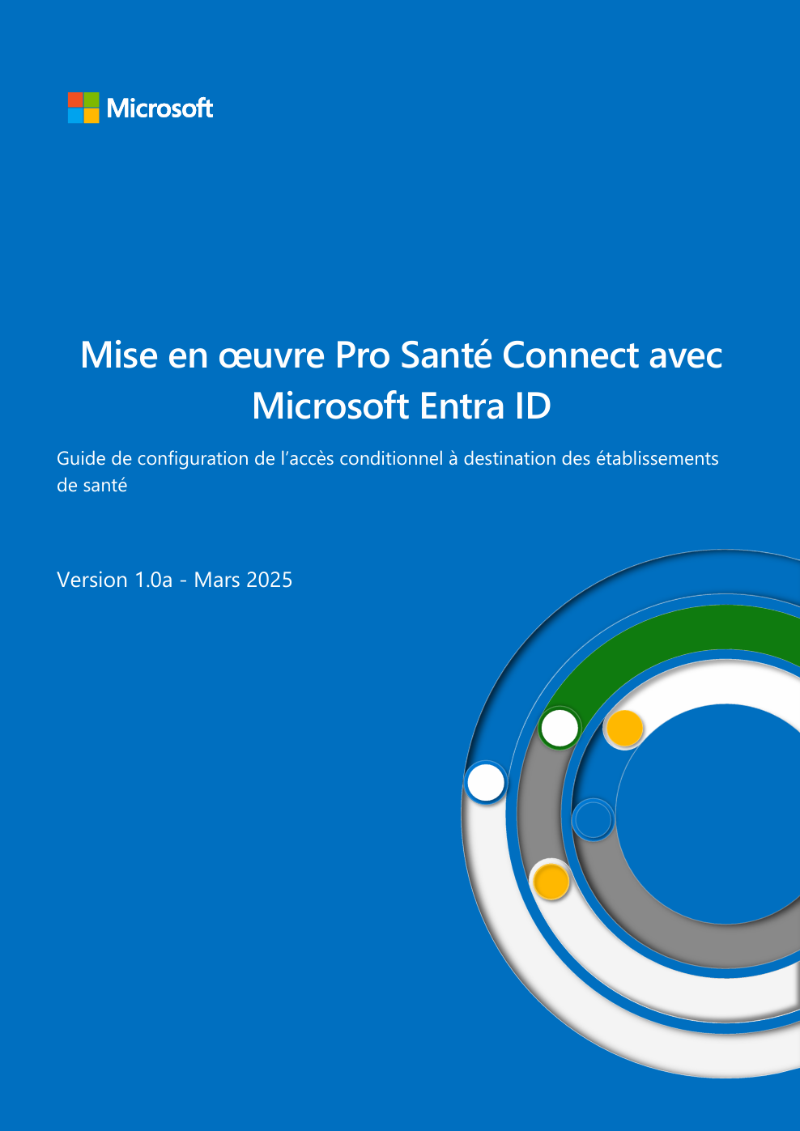
En complément du guide sur l’accès conditionnel
Pour la sécurisation de l’intégration PSC et plus largement pour assoir une trajectoire de sécurisation des locataires Entra ID des ES
Locataires Entra concernés pour cet atelier :
Priorité 1 : locataire pour l’intégration applicative de la plateforme PSC avec Entra ID
Priorité 2 : autres locataires
Et à utiliser conjointement
https://aka.ms/PSC_CA_EntraID

Slide 3
Qu'est-ce que l'accès conditionnel ?
Conditional Access capability of Microsoft Entra ID enables you to enforce controls on the access to applications in your environment based on specific conditions from a central location.
Note: This complements other authorization controls – application, role, and license assignment.
User – and location-based Conditional Access
Device-based Conditional Access
Application-based Conditional Access
Risk-based Conditional Access*
Keep sensitive data protected by limiting user access based on geo-location or IP address with location-based conditional access policies.
Ensure that only enrolled and approved devices can access corporate data with device-based conditional access.
Work doesn’t have to stop when a user is not on the corporate network. Secure access to corporate cloud and on‑premises apps and maintain control with conditional access.
Protect your data from hackers with a risk-based conditional access policy that can be applied to all apps and all users, whether on-premises or in the cloud.
* User and/or sign-in risk calculation requires Entra ID Premium P2

Slide 4


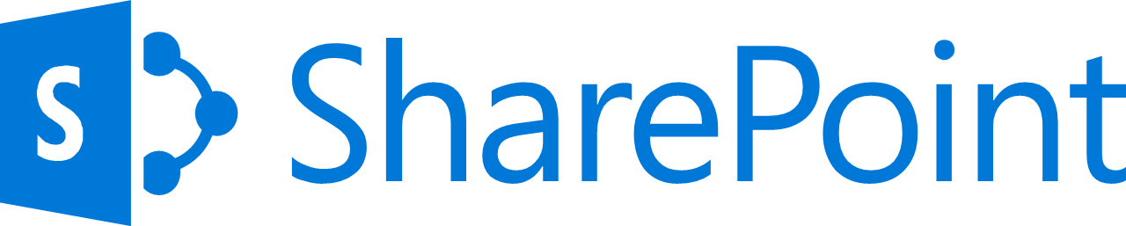







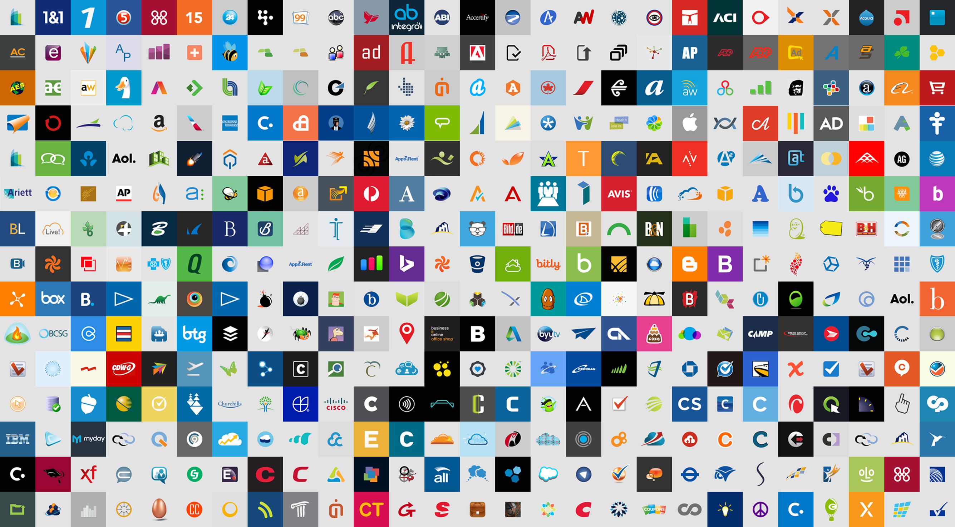


Entra ID
ADFS
Conditions
Controls
MSA
171TB
Google ID
Employee & Partner Users and Roles
Allow/block
access
Microsoft Cloud
Android
Session Risk
Machine learning
Microsoft Defender for Cloud Apps
iOS
3
Limited
access
Trusted & Compliant Devices
MacOS
Windows
Microsoft Defender ATP
Real time Evaluation Engine
Require
MFA
Cloud SaaS apps
Geo-location
Physical & Virtual Location
Force
password
reset
Corporate Network
Policies
******
Client apps & Auth Method
Effective policy
Browser apps
Block legacy authentication
On-premises apps
Client apps
Signal to make an informed decision
Decision based on organizational policy
Enforcement of policy across resources
Notes:
Here we are just giving you more of a visual on how we can control all those different what-if scenarios w/ CAPs.
-----
Previous Slide Notes
Following are some common access concerns that conditional access can help you with:
Network location: Entra ID is accessible from anywhere. What if an access attempt is performed from a network location that is not under the control of your IT department? A username and password combination might be good enough as proof of identity for access attempts from your corporate network. What if you demand a stronger proof of identity for access attempts that are initiated from other unexpected countries or regions of the world? What if you even want to block access attempts from certain locations?
Device management: In Entra ID, users can access cloud apps from a broad range of devices including mobile and also personal devices. What if you demand that access attempts should only be performed with devices that are managed by your IT department? What if you even want to block certain device types from accessing cloud apps in your environment?
Client application: Today, you can access many cloud apps using different app types such as web-based apps, mobile apps, or desktop apps. What if an access attempt is performed using a client app type that causes known issues? What if you require a device that is managed by your IT department for certain app types?
Sign-in risk: Entra ID Identity Protection detects sign-in risks. How do you restrict access if a detected sign-in risk indicates a bad actor? What if you would like to get stronger evidence that a sign-in was performed by the legitimate user? What if your doubts are strong enough to even block specific users from accessing an app?

Slide 5
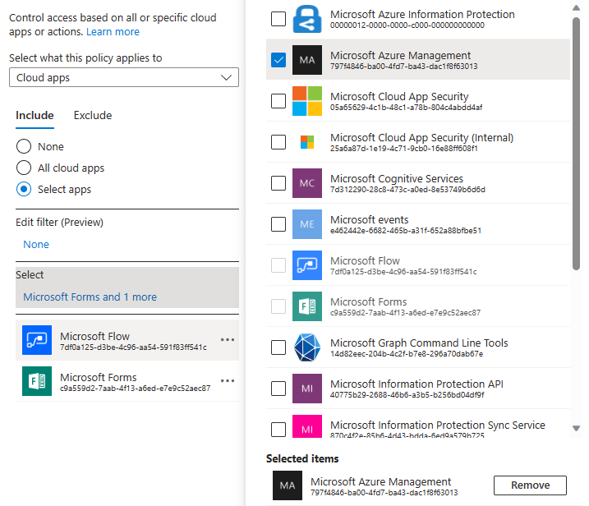
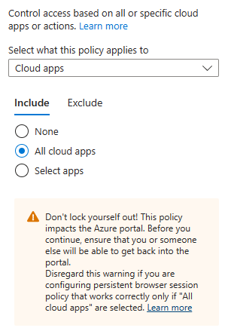
Accès conditionnel - Modèle d'accès
Conditional Access for targeted applications only
Conditional Access for All cloud apps (Zero Trust)
Area | Targeted Architecture | Zero Trust Architecture
Usability | 🙂 | 🙂
Functionality | 🙂 | 😐
Security | 🙁 | 🙂
Maintainability | 🙁 | 🙂
Not Recommended
Recommended

Slide 6
Sujets à couvrir pour cet atelier
L’accès conditionnel « dans le détail »
Les stratégies d’accès conditionnel pour une fondation sécurisée
Les stratégies d’accès conditionnel propres à PSC
Les prochaines étapes

Slide 7
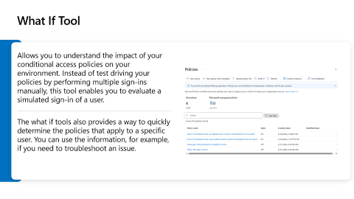
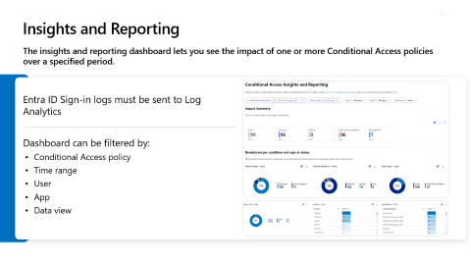
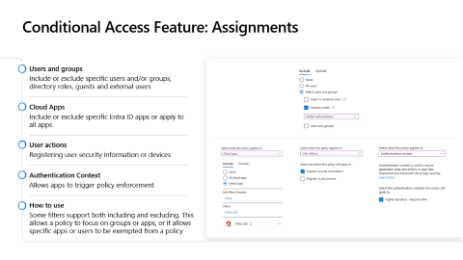

L’accès conditionnel « dans le détail »
Ce qu’il nous parait important de partager :
Rapport et surveillance pour les stratégies
Outil « What If »
Contrôles et fonctionnalités d’une stratégie
1
2
3

Slide 8
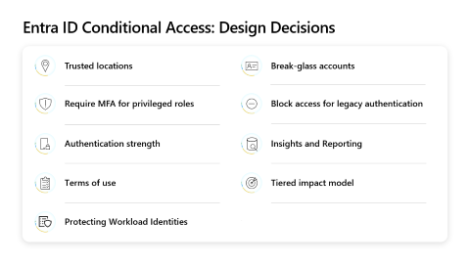
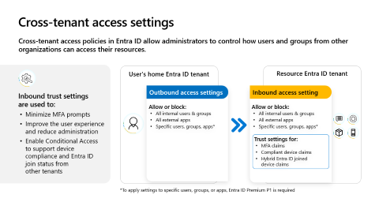
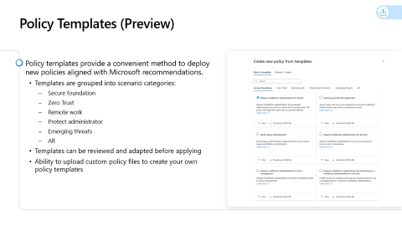


Les stratégies d’accès conditionnel pour une fondation sécurisée
Ce qu’il nous parait important de partager :
Modèles de stratégie d’accès
Paramètres pour l’accès entre locataires
Axes de conception pour l’accès conditionnel
4
5
6
Cf. :
Section 2 Planification des stratégies d’accès conditionnel Microsoft Entra ID
Section 3 Définition des stratégies d’accès conditionnel Microsoft Entra ID

Slide 9
Les stratégies d’accès conditionnel pour une fondation sécurisée
Nom
Affectations
Utilisateurs | Inclure Aucun Tous les utilisateurs Sélectionner des utilisateurs et des groupes Exclure Sélectionner les utilisateurs et groupes à exclure de la stratégie : Utilisateurs invites ou externes Rôles d’annuaire Utilisateurs et groupes
Ressources cibles | Applications cloud Actions de l’utilisateur Contexte d’authentification
Conditions | Risque de l’utilisateur Risque de connexion Plateformes d’appareils Emplacements Applications clientes Filtres pour les appareils
Contrôles d’accès
Octroyer | Bloquer l’accès Accorder l’accès Exiger une authentification multifacteur Exiger la force de l’authentification Exiger que l’appareil soit marqué comme conforme Exiger un appareil avec jointure Microsoft Entra hybride Demander une application cliente approuvée Exiger une stratégie de protection des applications Nécessite une modification du mot de passe Pour plusieurs contrôles Demander tous les contrôles sélectionnés Demander un des contrôles sélectionnés
Session | Utiliser les restrictions appliquées par l’application Utiliser le contrôle d’accès par accès conditionnel Fréquence de connexion Session de navigateur persistante Personnaliser l’évaluation de l’accès en continu Désactiver les valeurs par défaut de la résilience Exiger une protection par jeton pour les sessions de connexion (préversion) Utiliser le profil d’accès sécurisé global
Activer une stratégie | Rapport uniquement Activé Désactivé
Les modèles à retenir ?
Et leurs caractéristiques ?
Cf.
Section 4.2 Stratégies de modèles d’accès conditionnel pour une fondation sécurisée
Annexe B – Eléments de définition des stratégies

Slide 10

Les stratégies d’accès conditionnel propres à PSC
Deux canevas de stratégies de définis en l’état :
Conditions générales d’utilisation (CGU)
Cf. Section 4.3 Stratégie d’accès conditionnel pour les conditions générales d’utilisation (CGU) de PSC
Application Pro Santé Connect (PSC)
Cf. Section 4.3 Stratégie d’accès conditionnel l’accès à PSC sans couture

Slide 11

L’« automatisation » pour la mise en œuvre et le suivi
L'automatisation du déploiement et de la gestion des stratégies d'accès conditionnel présente certains avantages par rapport à une administration manuelle :
Keep track of changes via change management processes
Drastically reduce the risk of human errors
Allows automation of testing
Reduce time to deploy on scale
Automatically backup Conditional Access policies
Integrate approval workflows
Easy restoration of Conditional Access policies back to a given point in time
Enforce consistent naming of policies
Notes:
Drastically reduce the risk of human errors: Automation eliminates manual tasks that can potentially lead to mistakes in setting up or maintaining Conditional Access policies. It ensures that the policies are correctly implemented, thereby increasing the overall security posture.
Allows automation of testing: With automation, we can consistently test the impact of Conditional Access policies without affecting users. This can be done in a controlled environment which can emulate real-world conditions, ensuring the policies work as intended.
Integrate approval workflows: Automation can also be used to integrate an approval workflow into the policy creation and editing process. This adds an extra layer of security by requiring multiple approvals before any changes can go into effect.
Enforce consistent naming of policies: Automation can help enforce a consistent naming convention for Conditional Access policies. This can make managing and tracking policies easier, particularly in large organizations with numerous policies.
Keep track of changes via change management processes: Automation can integrate with change management processes to keep track of all changes made to Conditional Access policies. This helps to maintain an audit trail, enabling accountability and transparency.
Reduce time to deploy on scale: Automation can significantly speed up the process of deploying Conditional Access policies across an organization. This can be particularly beneficial in large-scale deployments where manual deployment could be time-consuming and prone to errors.
Automatically backup Conditional Access policies: Automation can be set up to regularly back up Conditional Access policies. This ensures that even in the event of an unexpected issue or error, the policies can be quickly restored from a backup.
Easy restoration of Conditional Access policies back to a given point in time: Automation also simplifies the process of restoring Conditional Access policies to a previous state. This could be crucial in situations where a recent change to a policy has caused unforeseen issues.

Slide 12
Les principales approches techniques pour l’« automatisation »
Moteur d’automatisation
Azure Automation
Azure Function App
Azure DevOps
Autre
API/Outillage
Microsoft Graph
Microsoft PowerShell
Solutions/Initiatives (en open-source)
Microsoft365DSC
Autres solutions communautaires
Solution personnalisée ad ’hoc
Notes:
Automation Engine
Azure Automation Account: Azure Automation Account is a cloud-based automation and configuration service that provides consistent management across your Azure and non-Azure environments. It’s highly scalable and reliable, and is ideal for automating repetitive and error-prone tasks.
Azure Function App: Azure Function App is a serverless compute service that enables you to run code on-demand without having to explicitly provision or manage infrastructure. It’s suitable for processing data, integrating systems, and building simple APIs and microservices.
Azure DevOps: Azure DevOps is a set of collaborative development tools built for the cloud. It’s a complete suite that can plan work, track progress, and release software. It’s beneficial for creating and managing Conditional Access policies throughout the entire lifecycle.
Other: There are many other automation engines available, depending on specific requirements. These could include third-party tools or custom-built solutions.
Tool / API
Microsoft Graph: Microsoft Graph is the gateway to data and intelligence in Microsoft 365. It provides a unified programmability model that can be used to access vast amounts of data within Microsoft 365, including Microsoft Entra ID. It’s particularly powerful for managing and automating Conditional Access policies.
Microsoft PowerShell: PowerShell is a scripting language that allows for advanced automation of Windows systems, including Entra ID. It can be used to create, manage, and delete Conditional Access policies, as well as to automate other tasks related to these policies.
Solutions
Microsoft365DSC: Microsoft365DSC is a powerful open-source tool that allows you to define and manage the configuration of your Microsoft 365 tenant, including Entra ID and Conditional Access policies. It’s especially useful for maintaining consistent configurations across different environments.
Community solutions: There are many community-driven solutions available for automating Conditional Access policy management. These solutions often leverage the tools and APIs mentioned above and are shared freely among the Microsoft community.
Custom solution: A custom solution refers to any solution that is specifically built to meet unique business needs. These solutions are often developed internally or by a third-party vendor and can provide a high degree of flexibility and customization.

Slide 13

Les ressources à considérer pour cette « automatisation »
Azure Architecture Center : Conditional Access for Zero Trust
https://learn.microsoft.com/en-us/azure/architecture/guide/security/conditional-access-zero-trust
Additional Guidance: Microsoft Entra ID Conditional Access principles and guidance : https://github.com/microsoft/ConditionalAccessforZeroTrustResources/blob/main/ConditionalAccessGovernanceAndPrinciplesforZeroTrust%20May%202022.pdf
Implementation Resources on GitHub : https://github.com/microsoft/ConditionalAccessforZeroTrustResources
With Microsoft365DSC : https://office365dsc.azurewebsites.net

Slide 14





Microsoft365DSC
An open-source Configuration-as-Code initiative using PowerShell Desired State Configuration (DSC) syntax)
Azure Key Vault
Validate & Approve
Admins
Get Credentials
Fork Admin1
Main Repository
Create Pull Request
Staging
Deploy
Check Pull Request
Compile MOFs
Deploy MOFs
Build Pipeline
Release Pipeline
Production
Commit
& Sync
Code Review & Merge PR
Master DSC Config
Build Pipeline
Admins
Add/Modify/Delete
Admin1
Integrating with Azure DevOps – Microsoft365DSC – Your Cloud Configuration
Notes:
Microsoft365DSC is a community-driven project which was started by Microsoft employees but is not officially supported by Microsoft support.
Microsoft365DSC is a powerful tool when integrated into DevOps processes within an enterprise setting.
It automates the Microsoft 365 Change Management process, allowing for any requested configuration changes to be tracked via systems such as Azure DevOps or GitHub.
These changes can then be automated across your various tenants once a change is approved.
This automated management of Microsoft 365 using Microsoft365DSC and Azure DevOps streamlines the change management process and enhances efficiency.
Please note that while this overview doesn’t delve into the specifics of integrating Microsoft365DSC with these systems, there is a comprehensive whitepaper available that provides a detailed guide on integrating Microsoft365DSC with Azure DevOps https://office365dsc.azurewebsites.net/Pages/Resources/Whitepapers/Managing%20Microsoft%20365%20with%20Microsoft365Dsc%20and%20Azure%20DevOps.pdf

Slide 15
D’autres ressources…
DCToolbox PowerShell Module for Microsoft 365 Security, Conditional Access Automation, and more – Daniel Chronlund Cloud Security Blog
AADOps : Operationalization of Entra ID Conditional Access https://www.cloud-architekt.net/aadops-conditional-access/

Slide 17
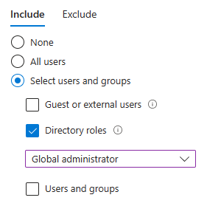
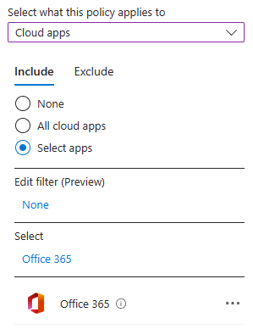
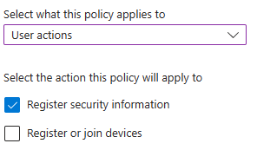
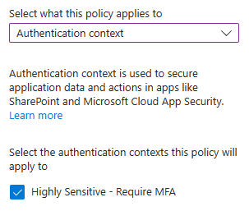
Conditional Access Feature: Assignments
Users and groups
Include or exclude specific users and/or groups, directory roles, guests and external users
Cloud Apps
Include or exclude specific Entra ID apps or apply to all apps
User actions
Registering user security information or devices
Authentication Context
Allows apps to trigger policy enforcement
How to use
Some filters support both including and excluding. This allows a policy to focus on groups or apps, or it allows specific apps or users to be exempted from a policy
Notes:
When creating Entra ID Conditional Access policies and targeting users who have Entra ID roles, it is important to consider that you may not cover new roles that are added to Entra ID in the future. This is because there is no "protect all roles" button in Entra ID Conditional Access policies, and you must manually select any roles that are added.
It is also important to note that these roles do not protect any admin roles outside of Entra ID, such as roles assigned in Microsoft 365 products like the Security & Compliance Center, Azure Pureview roles like super user, or Azure RBAC roles that are assigned on Azure resource level.
One potential workaround for this issue is to target groups instead of roles and ensure that role permissions are only granted via these groups. However, it is important to keep in mind that this may lead to a potential lack of coverage for anyone who is a direct role member instead of being a member of the group.

Slide 18
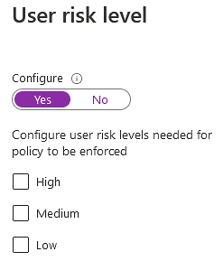
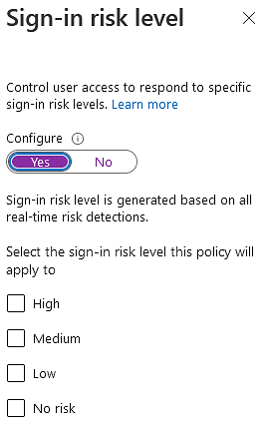
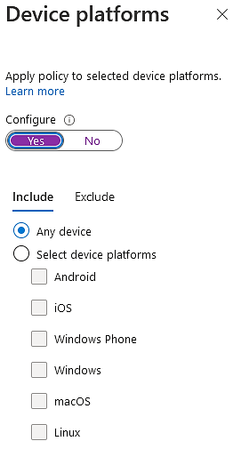
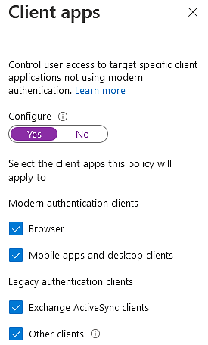
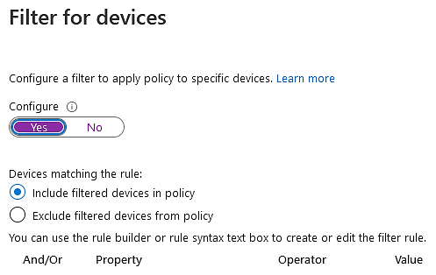
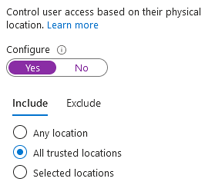
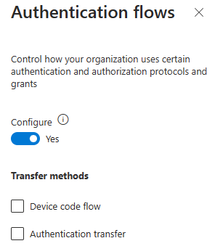
Conditional Access Feature: Conditions
Conditional Access policy triggers access controls when all conditions are met. Conditions are logically ’ANDed’.
“When does this happen” is called a condition.
“Then do this” is called an access control.
Available conditions:
User risk level
Sign-in risk level
Device platforms
Locations
Client apps
Filter for devices
Authentication flows (preview)
Notes:
Conditional Access is triggered on conditions and then restrictions are applied.

Slide 19
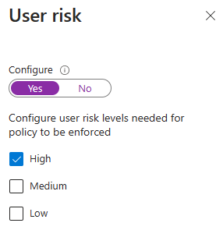
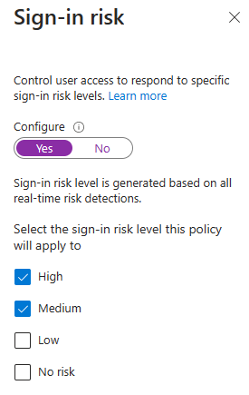
Conditions: User and sign-in risk
User and sign-in risks are calculated by Entra Identity Protection* and available as signals/conditions in Conditional Access.
If a risk is detected, users can be blocked from access or forced to perform additional security measures (e.g., step-up authentication or password change).
Risk policies should be configured in Conditional Access rather than Entra ID Identity Protection.
* User and/or sign-in risk calculation requires Entra ID Premium P2
Notes:
Be aware that a user risk can only be cleared in the user’s home tenant.
If you apply a risk policy to guest users, they eventually can’t access your resources until the risk has been cleared in their home tenant.

Slide 20
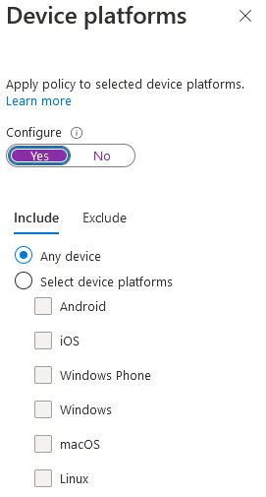
Conditions: Device Platforms
Available Device platforms
Any device (including unsupported)
Android
iOS
Windows Phone
Windows
macOS
Linux
If you choose Any device, you can exclude specific platforms on the Exclude tab.

Slide 21
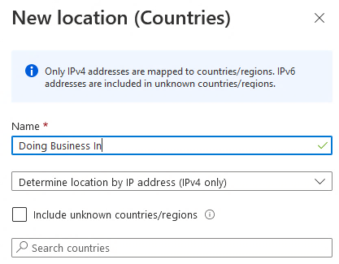
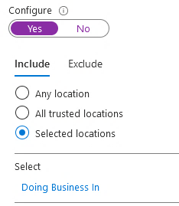
Conditions: Locations
Locations
Typically, trusted locations are network areas that your IT department controls.
Trusted named locations are also used by Microsoft Entra Identity Protection and Entra ID security reports to reduce false positives.
Country/Region
Using this option, you can select one or more countries or regions to define a named location. Consider defining countries into Doing Business/Activities In -, e.g., France, vs Not Doing Business/Activities In for defining policies.
Include unknown areas
Some IP addresses are not mapped to a specific country. This option allows you to choose if these IP addresses should be included in the named location. They could be checked when the named location policy applies to unknown locations.

Slide 22
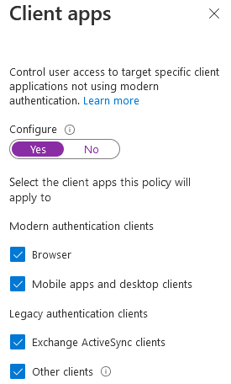
Conditions: Client Apps
Client apps use different protocols:
Browser: Passive federation clients using a web browser user agent string
Mobile apps and desktop clients:
Modern authentication: Uses passive federation, but with a different User Agent String
Exchange ActiveSync: EAS
Other clients: Legacy Authentication (Basic, WS-Trust, POP/IMAP)
Note: Using Browser condition with device controls requires specific versions of IE, Chrome, Edge and Safari (on Mac/iOS). Chrome requires an extension on Win 10 and registry edits on Win 7/8.1.
Some typical use cases for this control:
Enforce device controls on machines using apps that can download offline data
Force unmanaged devices to use only the browser for access
Block web access but allow mobile app access.
Block legacy protocols

Slide 23
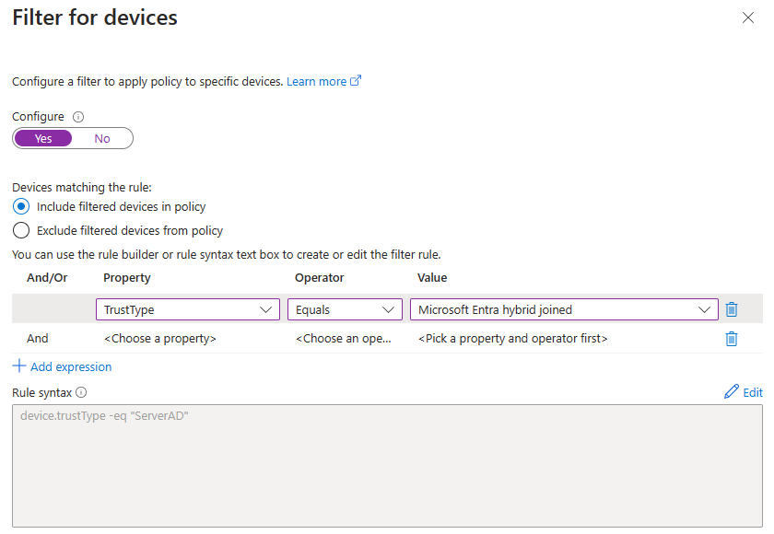
Conditions: Filter for Devices
You can now target specific devices using supported operators and properties for device filters and the other available assignment conditions in your Conditional Access policies.
Common Scenarios:
Restrict access to privileged resources (e.g., PAWs)
Block access to organization resources from devices running an unsupported Operating System
Do not require multifactor authentication for specific accounts on specific devices

Slide 24
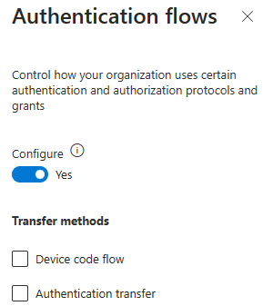
Authentication flows (Preview)
Authentication flows allow organizations to use certain authentication and authorization protocols and grants.

Slide 25
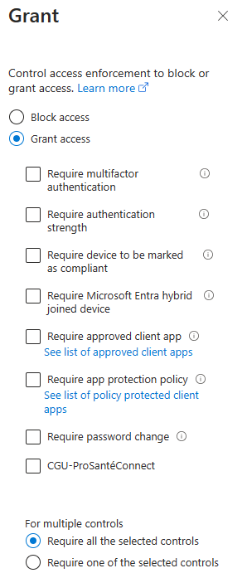
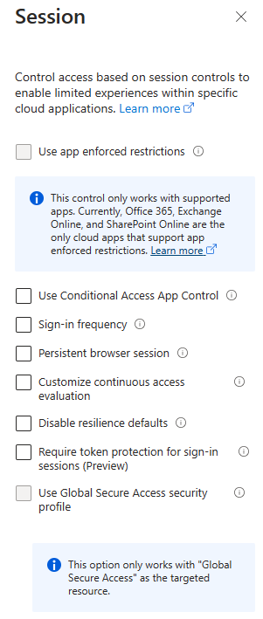
Conditional Access Features: Access Controls
Each control is either a requirement that must be fulfilled by the person or system signing in, or a restriction on what the user can do after signing in.
There are two types of controls:
Grant controls gate access
Session controls restrict access within a session
With grant controls, you can either block access altogether, or allow access with additional requirements by selecting the desired controls.
The session controls
are enforced by cloud apps and rely on additional information provided by Entra ID to the app about the session.

Slide 26
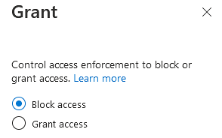
Controls: Block access
This explicit block overrides any grants.
Used when access to specific applications is not allowed for specific conditions.
Notes:
Using the “Block access” will overrule any other “Grant access” grant. Users won’t be able to access the service if a block access policy applies to them.

Slide 27
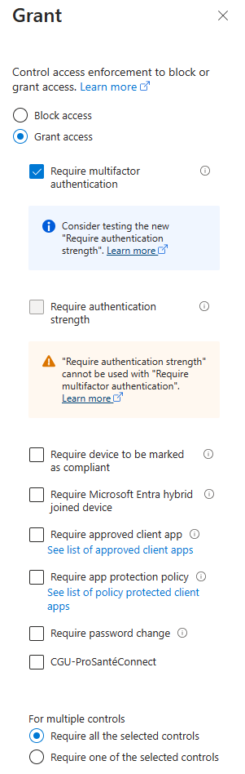
Controls: Require MFA
Requires the user to be authenticated using a second factor.
This grant control provides the same functionality as the authentication strength “Multifactor authentication”. It can be satisfied by the same authentication methods.
It is recommended to use the “Require authentication strength” control instead. See FA01-ProSantéConnect definition in the PSC CAP Guide

Slide 28
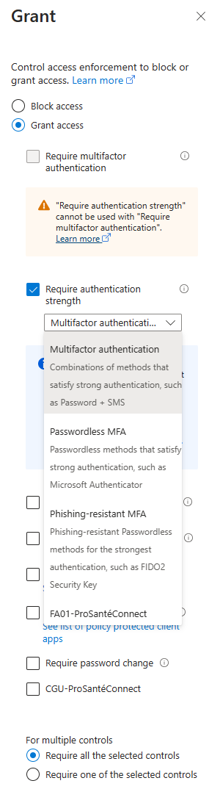
Controls: Require Authentication Strength
Authentication strength allows administrators to specify which combination of authentication methods satisfy the MFA requirement
Entra ID Premium 1 or higher needed
Combined security information registration must be enabled
Microsoft built-in authentication strengths:
Multifactor authentication
Password-less MFA
Phishing-resistant MFA
Custom authentication strength can be created
Admins can create custom authentication strength to exactly suit business requirements, e.g., FA01-ProSantéConnect
FIDO2: Can define trusted Authenticator Attestation GUIDs (AAGUIDs)

Slide 29
Built-in Authentication Strengths
Authentication method | MFA | Passwordless | Phishing Resistant
Password + SMS | ✓
Password + Phone Call | ✓
Password + Microsoft Authenticator (Push Notification) | ✓
Password + Software OATH token | ✓
Password + Hardware OATH token | ✓
Temporary Access Pass | ✓
Microsoft Authenticator (Phone Sign-in) | ✓ | ✓
Certificate Based Authentication | ✓ | ✓ | ✓
FIDO2 Security Key | ✓ | ✓ | ✓
Windows Hello for Business | ✓ | ✓ | ✓
Notes:
Microsoft Authenticator phone sign-in can be configured in phishing-resistant way though it is not considered phishing-resistant by the built-in authentication strength.
https://learn.microsoft.com/en-us/entra/standards/memo-22-09-multi-factor-authentication#protection-from-external-phishing
Microsoft Authenticator and conditional access policies that enforce managed devices. Managed devices are Hybrid Entra ID joined device or device marked as compliant.
Microsoft Authenticator can be installed on the device accessing the application protected by Entra ID or on a separate device.

Slide 30
Authentication Strength for external users
Authentication method | Home tenant | Resource tenant
SMS as second factor | ✓ | ✓
Voice call | ✓ | ✓
Microsoft Authenticator push notification | ✓ | ✓
Microsoft Authenticator phone sign-in | ✓ | ✓
OATH software token | ✓ | ✓
OATH hardware token | ✓
FIDO2 security key | ✓
Windows Hello for Business | ✓
Certificate Based Authentication | ✓
Temporary Access Pass | ✓
Notes:
When you apply an authentication strength Conditional Access policy to external Entra ID users, the policy works together with MFA trust settings in your cross-tenant access settings to determine where and how the external user must perform MFA.
In external user scenarios, the authentication methods that can satisfy authentication strength vary, depending on whether the user is completing MFA in their home tenant or the resource tenant.
If a resource tenant has opted to trust claims from external Entra ID organizations, only those claims listed in the “Home tenant” column below will be accepted by the resource tenant for MFA. If the resource tenant has disabled MFA trust, the external user must complete MFA in the resource tenant using one of the methods listed in the “Resource tenant” column.
For more information about how to set authentication strengths for external users, see Conditional Access - Authentication strength for external users - Microsoft Entra ID | Microsoft Learn: https://learn.microsoft.com/en-us/entra/identity/conditional-access/howto-conditional-access-policy-authentication-strength-external.

Slide 31
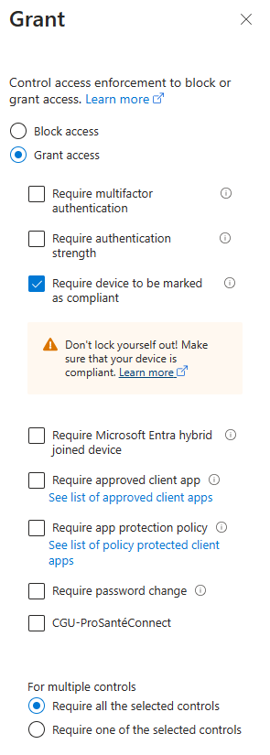
Controls: Require compliant device
Device is registered in Entra ID and is marked compliant by:
Microsoft Intune
Third party mobile device management that has been set up as a third-party device compliance partner in Intune*
* Requires licenses for Microsoft Intune
Notes:
Supported platforms include Android, iOS/iPadOS, and macOS, with support for a platform defined by the third party device compliance partner you use.
Technical reference:
Third-party device compliance partners support in Microsoft Intune | Microsoft Learn: https://learn.microsoft.com/en-us/mem/intune/protect/device-compliance-partners Device compliance policies in Microsoft Intune | Microsoft Learn: https://learn.microsoft.com/en-us/mem/intune/protect/device-compliance-get-started

Slide 32
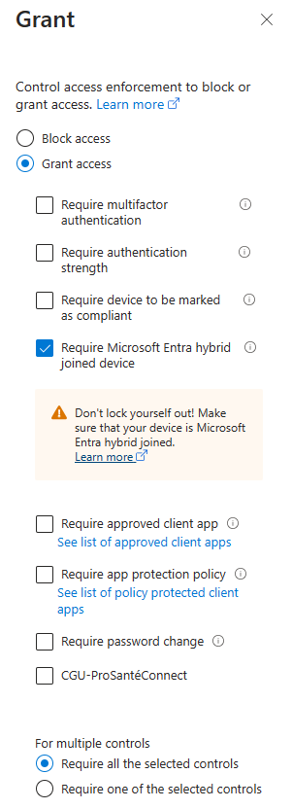
Controls: Require Entra hybrid joined device
Device must be hybrid joined. Does not include:
Entra ID registered (workplace joined) – personal devices registered with Entra ID
Entra ID joined – Windows 10/11 devices that are not joined to AD DS domain
Only applies to Windows 7/8/10/11 devices that are joined to AD DS domain and Entra ID
Implies device can be managed using GPO and/or management system such as SCCM
Relatively weak, as Entra ID cannot determine if the device is actively managed

Slide 33
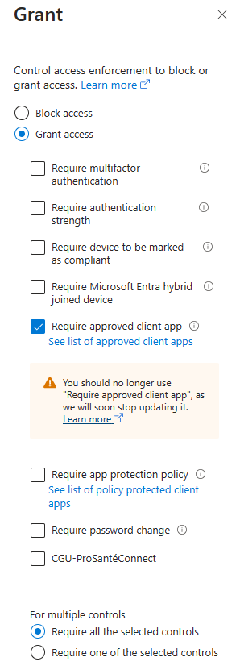
Controls: Require approved client app
Provides access for specific applications.
These applications support Intune mobile application management. Only applies to Android and iOS.
This differs from the client app condition, which is based on the access protocol that types of applications used.
Note: List of approved apps is at https://aka.ms/supportedmamapps
Notes:
Grant controls in Conditional Access policy - Microsoft Entra ID | Microsoft Learn: https://learn.microsoft.com/en-us/entra/identity/conditional-access/concept-conditional-access-grant#require-approved-client-app

Slide 34
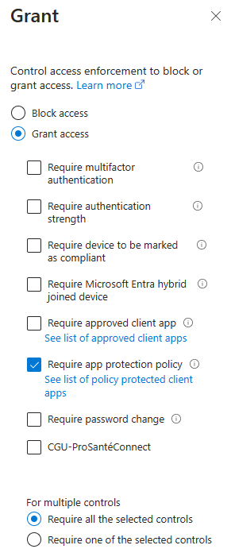
Controls: Require app protection policies
Mobile Application Management (MAM) app protection policies allow you to manage and protect your organization’s data within an application.
To apply this grant control, Conditional Access requires that the device is registered in Entra ID, which requires using a broker app.
Note: List of approved apps is at https://aka.ms/supportedmamapps
Notes:
Grant controls in Conditional Access policy - Microsoft Entra ID | Microsoft Learn: https://learn.microsoft.com/en-us/entra/identity/conditional-access/concept-conditional-access-grant#require-app-protection-policy

Slide 35
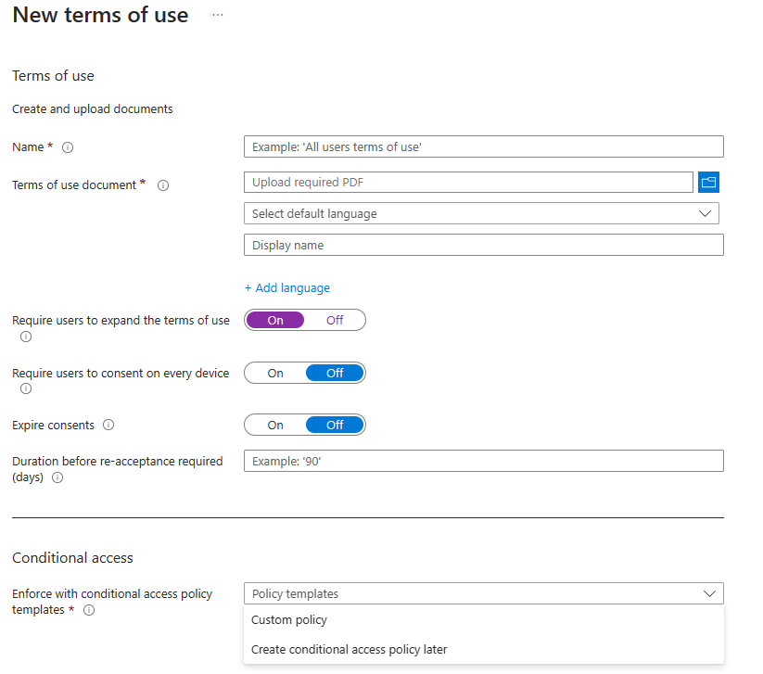
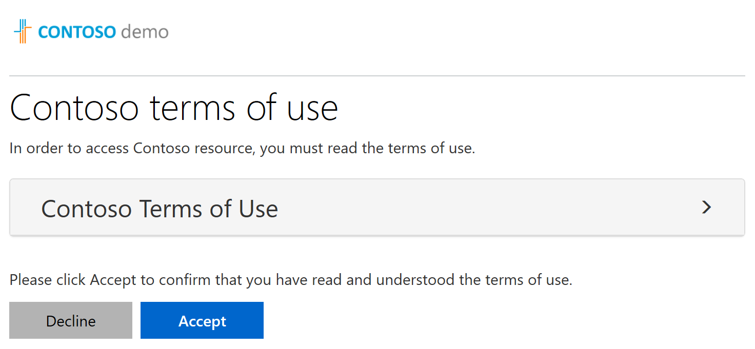
Controls: Terms of use
User acceptance is tracked
Terms of use documents shown inline in browser
Can require users to display the terms before accepting
Expiration and re-acceptance periods are definable
Cf. CGU-ProSantéConnect in the PSC CAP Guide

Slide 36
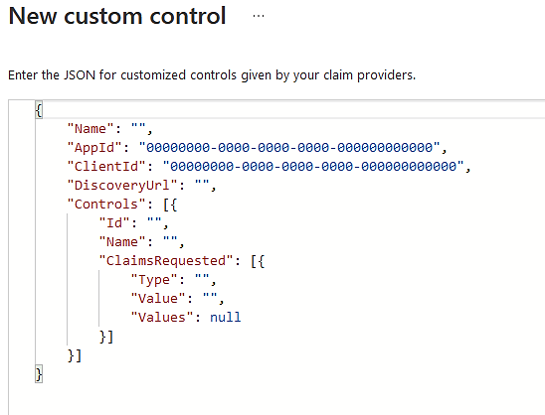
Controls: Custom Controls (Preview)
Providers currently offering a compatible service include:
Duo security
Entrust datacard
Ping identity
RSA
SecureAuth
Silverfort
Symantec VIP
Trusona
Conditional Access submits a request over federation protocols for an additional claim. The 3rd party service then performs additional authentication and then signs and returns the claim back to Entra ID.
Notes:
Custom controls can’t be used with Identity Protection’s automation requiring Entra ID Multifactor Authentication, Entra ID self-service password reset (SSPR), satisfying multifactor authentication claim requirements, to elevate roles in Privileged Identity Manager (PIM), as part of Intune device enrollment, or when joining devices to Entra ID.
Custom controls in Microsoft Entra Conditional Access - Microsoft Entra ID | Microsoft Learn: https://learn.microsoft.com/en-us/entra/identity/conditional-access/controls

Slide 37
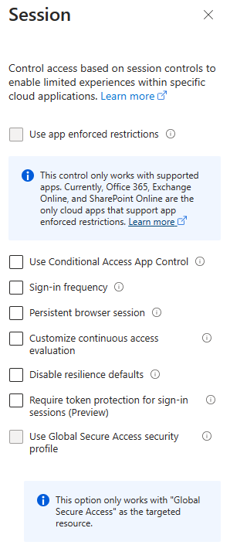
Controls: Session Controls
01
Enforce additional controls in cloud apps based on device state (device is compliant or domain joined)
02
Currently works with Office 365, Exchange Online and SharePoint Online
03
Controls are enforced by the app, with data from Entra ID
04
Requires corresponding configuration in Exchange Online and SharePoint Online Admin Center

Slide 38
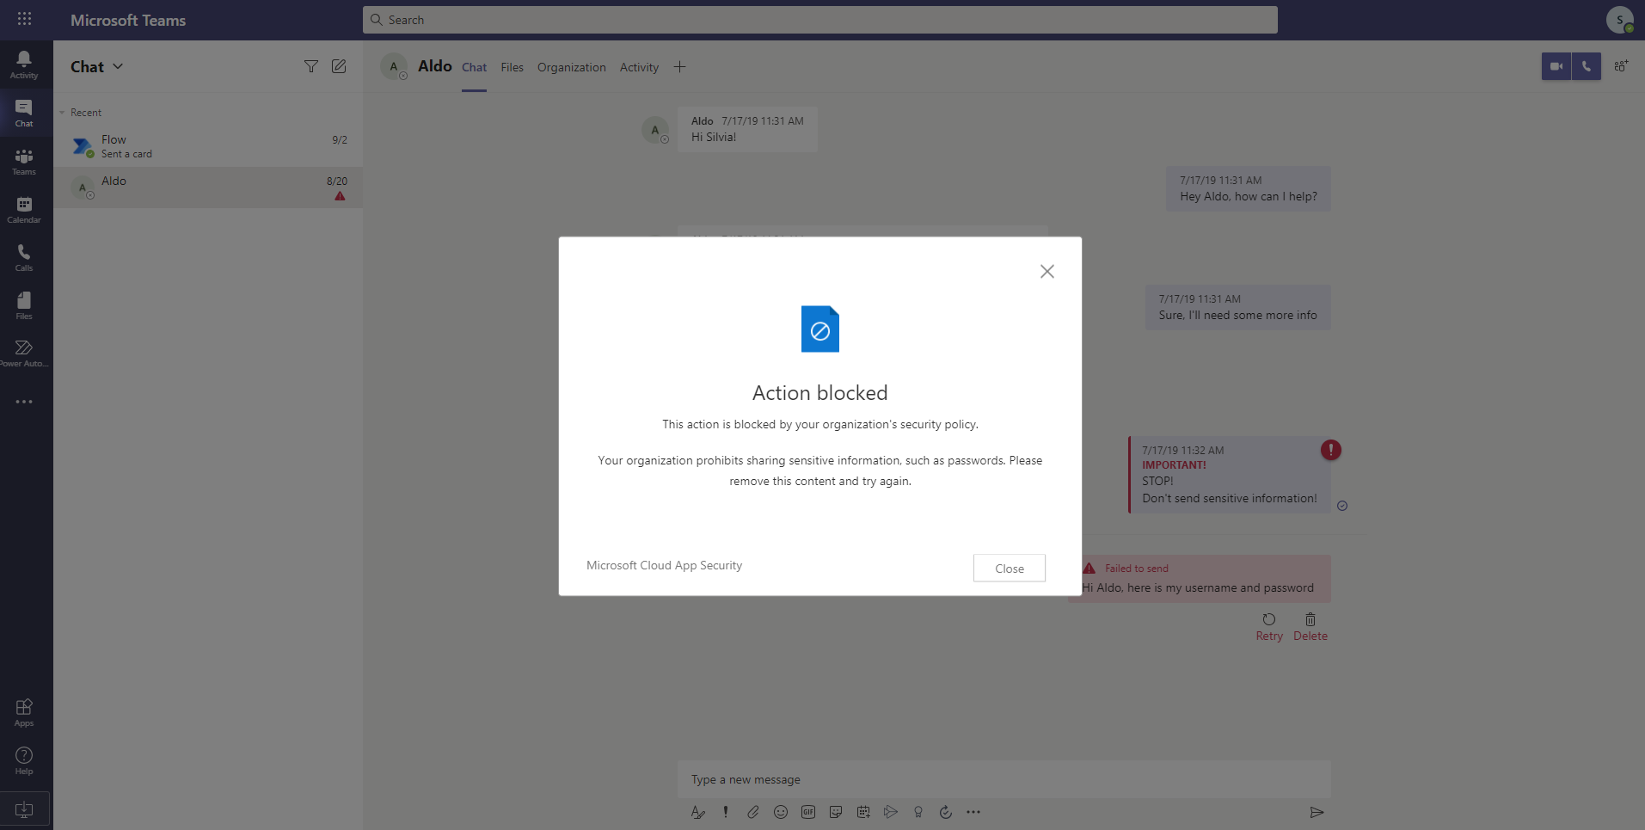
Real-time in-session App Control
Context-aware session policies
Control access to cloud apps and sensitive data within those apps based on user, location, device, and the status of the application within the environment
SAML, Open ID Connect, & on-prem apps
Support for any web app onboarded via an enterprise-level identity provider
Data Exfiltration:
Block download, Apply AIP label on download
Block print
Block copy/cut
Block custom activities: (e.g., IMs with sensitive content)
Data Infiltration:
Block upload
Block paste
Notes:
Microsoft Defender for Cloud Apps (MDCA) can evaluate sessions in real-time leveraging the conditional access from initial parameters of session access, throughout the access of the app. Support for any web app onboarded via an enterprise-level identity provider, such as Microsoft Entra ID, Okta and Ping.

Slide 39





Controls: Use Conditional Access App Control
Microsoft Azure
Interactive Traffic
Microsoft 365
Microsoft Defender for Cloud Apps
Access or session policy
Other SaaS apps connected to MDCA
Conditional Access
All Cloud Apps
Session Control
Users
Non-Interactive Traffic
Microsoft Entra ID
& Microsoft Graph

Slide 40
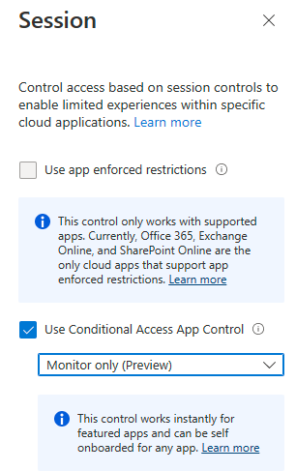
Controls: App Control – Monitor
Typically used to monitor and alert on users’ behavior in MDCA as well as if you want MDCA to detect a new application or web sites that you want to protect access to using MDCA policies because it may not be targetable in Conditional Access.

Slide 41
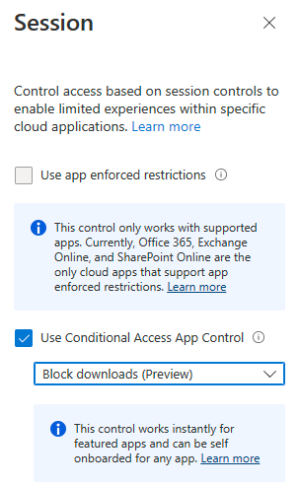
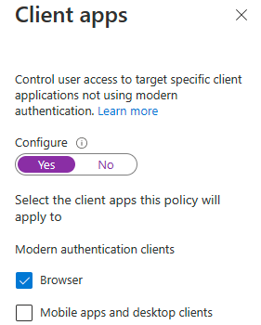
Controls: App Control – Monitor – Block downloads
Typically used for read-only access to resources not supported by App Restrictions. Only web-based applications are supported. Consider if all or only web traffic is sent to MDCA.

Slide 42
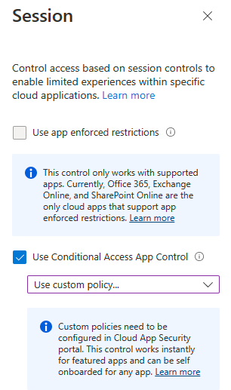
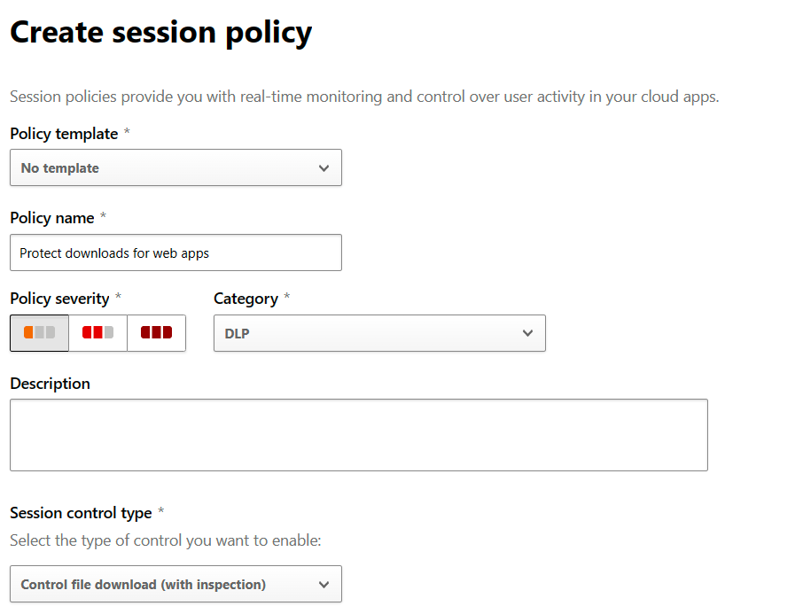
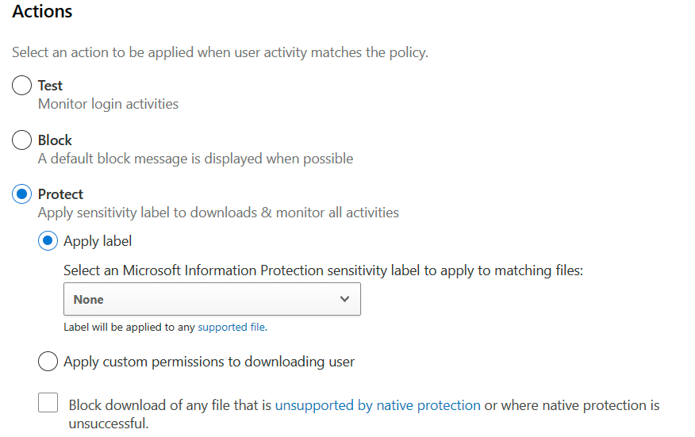
Controls: App Control – MDCA Custom Policy
Typically used to restrict uploads/downloads.
Examples include downloading content and protecting it with a Microsoft Information Protection label.
Only supported for web-based access.

Slide 43






Controls: App Control – Example Guest User Access
Microsoft Azure
Conditional Access
All Cloud Apps
Session Control
Microsoft 365
Interactive Traffic
Users
Microsoft Defender for Cloud Apps
Access policy
MFA Registration
Conditional Access Policy
Microsoft Defender for Cloud Apps Policy
Notes:
Sometimes you may want to restrict users to only use Microsoft 365 services. While you can create a regular Conditional Access policy that blocks access to all cloud applications except Office 365, you are then unable to enforce MFA for these guest accounts since access to the registration page is also blocked. Since you can’t exclude the MFA registration endpoint in the CA portal, the solution would typically not be accepted.
If you’d rather use a Conditional Access session policy with app control, you can use MDCA to allow access to only Office 365 and the _mysignins.microsoft.com_ endpoint.

Slide 44

Controls: Sign-in Frequency – Every Time
There are scenarios like the ones for PSC where you may want to require a fresh authentication every time before a user performs specific actions.
For most risk-based Conditional Access policies, a user may not be enforced to MFA again if they have an MFA claim already. Sign-in frequency has a new option for Every time in addition to hours or days, which ensures that the user is forced to do MFA regardless of any outstanding claim.
Supported scenarios:
Require user reauthentication after a defined period for a sensitive application
Require user reauthentication during Intune device enrolment, regardless of their current MFA status.
Require user reauthentication for risky users with the require password change grant control.
Require user reauthentication for risky sign-ins with the require multifactor authentication grant control.

Slide 45

Controls: Authentication context
The authentication context serves as a crucial component in safeguarding data and actions within various applications, including SharePoint, MDCA (Microsoft Defender for Cloud Apps), and Entra ID PIM.
Additionally, it can be utilized in conjunction with custom applications or LOB applications. Essentially, it functions as a conduit that connects applications with Conditional Access policies. Once the authentication context is established, we can associate a Conditional Access policy with it. Subsequently, within the application itself, we can designate the authentication context and enforce the policy settings linked to it.
Authentication contexts are managed in the Entra admin center portal under Protection > Conditional Access > Authentication context.
Notes:
Authentication context can be used to further secure data and actions in applications. These applications can be your own custom applications, custom line of business (LOB) applications, applications like SharePoint, or applications protected by Microsoft Defender for Cloud Apps.
For example, an organization may keep files in SharePoint sites like the lunch menu or their secret BBQ sauce recipe. Everyone may have access to the lunch menu site, but users who have access to the secret BBQ sauce recipe site may need to access from a managed device and agree to specific terms of use.
Use sensitivity labels with Microsoft Teams, Microsoft 365 Groups, and SharePoint sites | Microsoft Learn: https://learn.microsoft.com/en-us/purview/sensitivity-labels-teams-groups-sites
Session policies - Microsoft Defender for Cloud Apps | Microsoft Learn: https://learn.microsoft.com/en-us/defender-cloud-apps/session-policy-aad?branch=pr-en-us-2082#require-step-up-authentication-authentication-context
Developer guidance for Microsoft Entra Conditional Access authentication context - Microsoft identity platform | Microsoft Learn: https://learn.microsoft.com/en-us/entra/identity-platform/developer-guide-conditional-access-authentication-context

Slide 46
Authentication Context – Examples
The IT administrators and regulators often struggle between balancing prompting their users with additional factors of authentication too frequently and achieving adequate security and policy adherence for applications and services where parts of them contain sensitive data and operations. Conditional Access authentication context (auth context) allows you to apply granular policies to sensitive data and actions instead of just at the app level. For example, we can use Authentication context with the following use cases:
User signs into SharePoint using Multi-Factor Authentication, but when they are accessing site collection in SharePoint which contains sensitive documents, they require a compliant device and to be within trusted IP ranges.
Entra Privileged Identity Management (PIM) offers the capability to enforce Multi-Factor Authentication (MFA) verification during the activation process. However, before granting a user access to a highly sensitive role, it is imperative for the organization to verify two crucial factors: The compliance status of the user’s device and its Entra ID join status.
The organization enables users to handle sensitive data; however, when it comes to uploading or downloading such data, they prefer to validate certain claims, including Multi-Factor Authentication (MFA) and device compliance status. This verification process ensures that additional security measures are in place to safeguard the sensitive data during its transfer.
Notes:
The implementation of authentication context has a few limitations, which include:
Limited app support: The authentication context may not be compatible with all applications, as it has support for a specific number of apps.
PIM integration in public preview: The integration of Privileged Identity Management (PIM) with the authentication context is still in the public preview phase, indicating that it may not have full feature availability or stability.
Maximum of 25 authentication contexts: There is a restriction on the number of authentication contexts that can be set up, allowing a maximum of 25 contexts.
Additional configuration steps for app implementation: Custom or line-of-business (LOB) applications require extra configuration steps to implement the authentication context, adding complexity to the setup process.
Due to these limitations, scoping slides are not employed for the authentication context topic, as it is important to highlight the potential challenges and constraints associated with its implementation.

Slide 47


Conditional Access for Workload Identities
There are two primary categories of identities: Human identities and machine/non-human identities. Within the realm of machine identities, we can further classify them into two subgroups: Workload identities and device identities. The former pertains to software workloads, whereas the latter encompasses various devices like desktop computers, mobile devices, IoT sensors, and managed IoT devices.
As time progresses, the reliance on non-human entities to perform crucial tasks is growing significantly. However, this increasing reliance poses a potential risk for enterprises, as it becomes increasingly challenging to ensure the security of workload identities.

Slide 48
Conditional Access for Workload Identities
While it is not feasible to employ fundamental protection measures like Multi-Factor Authentication for safeguarding workload identities, it is still possible to implement specific security controls through the implementation of Conditional Access policies.
Location-based Conditional Access policy – Create a Conditional Access policy that restricts the access of workload identities originating from external IP ranges not deemed as trusted.
Risk-based Conditional Access policy – Entra ID Identity Protection is capable of detecting, investigating, and remediating identity-based risks on workload identities. By using conditional access policy, you can block access for workload identities when identity protection mark them “at risk.
Microsoft Entra Conditional Access for workload identities
Notes:
Microsoft Entra Conditional Access for workload identities - Microsoft Entra ID | Microsoft Learn: https://learn.microsoft.com/en-us/entra/identity/conditional-access/workload-identity#create-a-location-based-conditional-access-policy
Securing workload identities with Microsoft Entra ID Protection - Microsoft Entra ID Protection | Microsoft Learn: https://learn.microsoft.com/en-us/entra/id-protection/concept-workload-identity-risk#workload-identity-risk-detections

Slide 49
Processing Conditional Access policies
Conditional Access policies are assessed for all sign-in and authorization requests, not for each application request.
List of applicable policies is determined:
During evaluation of each policy, all conditions are AND’ed.
All applicable policies are enforced:
Conditions for all applicable policies must be satisfied before access is granted.
Controls within each policy may be AND’ed or OR’ed.
Any block will override all grants.

Slide 50

VPN with Conditional Access
1
Create certificate in the Conditional Access portal
2
Import cert into VPN configuration
Entra ID issues a VPN use certificate for Windows 10/11 when a client satisfies a conditional access policy
3
Overview
Design
Plan
Notes:
Configure conditional access for VPN connectivity using Microsoft Entra ID | Microsoft Learn: https://learn.microsoft.com/en-us/Windows-server/remote/remote-access/how-to-aovpn-conditional-access

Slide 51


Insights and Reporting
The insights and reporting dashboard lets you see the impact of one or more Conditional Access policies over a specified period.
Entra ID Sign-in logs must be sent to Log Analytics
Dashboard can be filtered by:
Conditional Access policy
Time range
User
App
Data view

Slide 52

Report-only Mode
Report-only mode is a Conditional Access policy state that allows administrators to evaluate the impact of Conditional Access policies before enabling them in their environment. In report-only mode:
Conditional Access policies can be enabled in report-only mode.
During sign-in, policies in report-only mode are evaluated but not enforced.
Results are logged in the Conditional Access and Report-only tabs of the Sign-in log details.
Customers with an Azure Monitor subscription can monitor the aggregate impact of their Conditional Access policies using the Conditional Access insights workbook.
Notes:
Policies in report-only mode that require compliant devices may prompt users on Mac, iOS, and Android to select a device certificate during policy evaluation, even though device compliance is not enforced. These prompts may repeat until the device is made compliant. To prevent end users from receiving prompts during sign-in, exclude device platforms Mac, iOS and Android from report-only policies that perform device compliance checks. Note that report-only mode is not applicable for Conditional Access policies with "User Actions" scope.

Slide 53


Report-only Mode
Status Results
Success
All configured policy conditions, required non-interactive grant controls, and session controls were satisfied.
Failure
All configured policy conditions were satisfied but not all the required non-interactive grant controls or session controls were satisfied.
User action required
All configured policy conditions were satisfied but user action would be required to satisfy the required grant controls or session controls.
Not applied
Not all configured policy conditions were satisfied.
Notes:
Result
Report-only: Success
All configured policy conditions, required non-interactive grant controls, and session controls were satisfied.
For example, a multi-factor authentication requirement is satisfied by an MFA claim already present in the token, or a compliant device policy is satisfied by performing a device check on a compliant device.
Report-only: Failure
All configured policy conditions were satisfied but not all the required non-interactive grant controls or session controls were satisfied. For example, a policy applies to a user where a block control is configured, or a device fails a compliant device policy.
Report-only: User action required
All configured policy conditions were satisfied but user action would be required to satisfy the required grant controls or session controls. With report-only mode, the user is not prompted to satisfy the required controls. For example, users are not prompted for multi-factor authentication challenges or terms of use.
Report-only: Not applied
Not all configured policy conditions were satisfied. For example, the user is excluded from the policy or the policy only applies to certain trusted named locations.

Slide 54

What If Tool
Allows you to understand the impact of your conditional access policies on your environment. Instead of test driving your policies by performing multiple sign-ins manually, this tool enables you to evaluate a simulated sign-in of a user.
The what if tools also provides a way to quickly determine the policies that apply to a specific user. You can use the information, for example, if you need to troubleshoot an issue.

Slide 55

What If Tool
Configure the settings of the sign-in scenario you want to simulate.
These settings can include:
The user or workload identity you want to test
The cloud apps, actions or authentication context the user would attempt to access
The conditions under which access to the configures cloud apps is performed

Slide 56


What If Tool
Policies that will apply
Policies that will not Apply And Reason why

Slide 57

Policy Templates (Preview)
Policy templates provide a convenient method to deploy new policies aligned with Microsoft recommendations.
Templates are grouped into scenario categories:
Secure foundation
Zero Trust
Remote work
Protect administrator
Emerging threats
All
Templates can be reviewed and adapted before applying
Ability to upload custom policy files to create your own policy templates
Notes:
Secure your resources with Conditional Access policy templates - Microsoft Entra ID | Microsoft Learn: https://learn.microsoft.com/en-us/entra/identity/conditional-access/concept-conditional-access-policy-common?tabs=secure-foundation

Slide 58
Common Policies for Conditional Access
Some policies are commonly used across various customer types and scenarios:
Block access for unknown or unsupported device platform
No persistent browser session
Require approved client apps or app protection
Require a compliant device, Microsoft Entra hybrid joined device, or multifactor authentication for all users
Require compliant or Microsoft Entra hybrid joined device for administrators
Require multifactor authentication for guest access
Securing security info registration
Use application enforced restrictions for unmanaged devices
Sign-in risk-based multifactor authentication*
User risk-based password change*
Block legacy authentication**
Require multifactor authentication for admins**
Require multifactor authentication for all users**
Require multifactor authentication for Azure management**
*Requires Entra ID Premium P2
**These four policies provide similar functionality enabled by security defaults
Notes:
All these policies are available as policy templates.
References for common policies: Secure your resources with Conditional Access policy templates - Microsoft Entra ID | Microsoft Learn: https://learn.microsoft.com/en-us/entra/identity/conditional-access/concept-conditional-access-policy-common?tabs=secure-foundation
Require MFA for administrators with Conditional Access - Microsoft Entra ID | Microsoft Learn: https://learn.microsoft.com/en-us/entra/identity/conditional-access/howto-conditional-access-policy-admin-mfa
Block access for unknown or unsupported device platform: This policy helps in preventing access to your resources from unknown or unsupported devices, thus providing an additional layer of security. See Block unsupported platforms with Conditional Access - Microsoft Entra ID | Microsoft Learn: https://learn.microsoft.com/en-us/entra/identity/conditional-access/howto-policy-unknown-unsupported-device
No persistent browser session: Enforcing this policy ensures that users do not remain signed into the application after closing the browser, mitigating the risk of unauthorized access. See Require reauthentication with Conditional Access - Microsoft Entra ID | Microsoft Learn: https://learn.microsoft.com/en-us/entra/identity/conditional-access/howto-policy-persistent-browser-session
Require approved client apps or app protection policy: This policy requires users to use approved client apps for access, which provides better protection against potential security threats. See Conditional Access - Require approved app or app protection policy - Microsoft Entra ID | Microsoft Learn: https://learn.microsoft.com/en-us/entra/identity/conditional-access/howto-policy-approved-app-or-app-protection
Require a compliant device, Microsoft Entra hybrid joined device, or multifactor authentication for all users: This policy ensures that only devices that are compliant with your organization’s security standards or are hybrid Entra ID joined can access resources. If these conditions are not met, users are required to authenticate using a second factor. See Require compliant, hybrid joined devices, or MFA - Microsoft Entra ID | Microsoft Learn: https://learn.microsoft.com/en-us/entra/identity/conditional-access/howto-conditional-access-policy-compliant-device
Require compliant or Microsoft Entra hybrid joined device for administrators: Like the previous policy, but specifically for administrative accounts, which often have higher privileges and thus pose a greater security risk if compromised. See Require administrators use compliant or hybrid joined devices - Microsoft Entra ID | Microsoft Learn: https://learn.microsoft.com/en-us/entra/identity/conditional-access/howto-conditional-access-policy-compliant-device-admin
Require multifactor authentication for guest access: This policy adds an extra layer of security for guest users, who might not follow the same security practices as your internal users. See Require MFA for guest users with Conditional Access - Microsoft Entra ID | Microsoft Learn: https://learn.microsoft.com/en-us/entra/identity/conditional-access/howto-policy-guest-mfa
Securing security info registration: This policy helps in securing the process of security information registration. See Control security information registration with Conditional Access - Microsoft Entra ID | Microsoft Learn: https://learn.microsoft.com/en-us/entra/identity/conditional-access/howto-conditional-access-policy-registration
Use application enforced restrictions for unmanaged devices: This policy allows you to enforce application-level restrictions for devices that are not managed by your organization. See Conditional Access - Use application enforced restrictions for unmanaged devices - Microsoft Entra ID | Microsoft Learn: https://learn.microsoft.com/en-us/entra/identity/conditional-access/howto-policy-app-enforced-restriction
Sign-in risk-based multifactor authentication: This policy, which requires Entra ID Premium P2, triggers additional authentication challenges during sign-ins that are deemed risky. See Sign-in risk-based multifactor authentication - Microsoft Entra ID | Microsoft Learn: https://learn.microsoft.com/en-us/entra/identity/conditional-access/howto-conditional-access-policy-risk
User risk-based password change: Also requiring Entra ID Premium P2, this policy forces users that are considered high-risk to change their password. See User risk-based password change - Microsoft Entra ID | Microsoft Learn: https://learn.microsoft.com/en-us/entra/identity/conditional-access/howto-conditional-access-policy-risk-user
Block legacy authentication, Require multifactor authentication for admins, Require multifactor authentication for all users, and Require multifactor authentication for Azure management: These four policies provide similar functionality enabled by security defaults. They are designed to block outdated authentication methods and enforce multifactor authentication, increasing the security of both user and administrative accounts and Azure management tasks.
See
Block legacy authentication with Conditional Access - Microsoft Entra ID | Microsoft Learn: https://learn.microsoft.com/en-us/entra/identity/conditional-access/howto-conditional-access-policy-block-legacy
Require MFA for administrators with Conditional Access - Microsoft Entra ID | Microsoft Learn: https://learn.microsoft.com/en-us/entra/identity/conditional-access/howto-conditional-access-policy-admin-mfa
Require MFA for all users with Conditional Access - Microsoft Entra ID | Microsoft Learn: https://learn.microsoft.com/en-us/entra/identity/conditional-access/howto-conditional-access-policy-all-users-mfa
Require MFA for Azure management with Conditional Access - Microsoft Entra ID | Microsoft Learn: https://learn.microsoft.com/en-us/entra/identity/conditional-access/howto-conditional-access-policy-azure-management

Slide 59
Break-glass accounts
It is possible to lock out access when applying a policy to all cloud apps or to Azure Resource Management API (e.g., Azure portal).
We recommend excluding specific break-glass account(s) from the policy.
Ensure the password for any break-glass account is stored securely.

Slide 60

Cross-tenant access settings
Cross-tenant access policies in Entra ID allow administrators to control how users and groups from other organizations can access their resources.
Outbound access settings
Inbound access setting
User’s home Entra ID tenant
Resource Entra ID tenant
Inbound trust settings are used to:
Minimize MFA prompts
Improve the user experience and reduce administration
Enable Conditional Access to support device compliance and Entra ID join status from other tenants
Allow or block:
All internal users & groups
All external apps
Specific users, groups, apps*
Allow or block:
All internal users & groups
All external apps
Specific users, groups, apps*
Trust settings for:
MFA claims
Compliant device claims
Hybrid Entra ID joined device claims
*To apply settings to specific users, groups, or apps, Entra ID Premium P1 is required

Slide 61

Cross-Tenant Access Settings – Trust Settings
01
By default, inbound access trust settings are set to not accept MFA and device states from other organizations
02
Trust settings can be configured for every partner organization
03
Conditional Access policy still must be configured in resource tenant to require MFA or compliant device to grant access
04
MFA and device compliance requirements are proofed in the user’s home tenant
05
MFA and device compliance state is verified in resource tenant, but not their requirements
06
Use additional conditional access policies with authentication strength to protect apps with higher security requirements
Notes:
Adding a cross-tenant access trust setting does not require the partner tenant, a.k.a. home tenant, to provide MFA or a trusted device to access resources. A conditional access policy is still required to enforce grant control.
Especially in multi-tenant organizations the use of cross-tenant access settings is helpful to significantly increase the user experience and lower the administrative effort.
However, this also means giving up some control because the partner organization’s MFA strength and device compliance policies cannot be checked again in the own organization. The partner tenant sets the requirements, and they are trusted without further verification.
Client compliance and MFA satisfaction are checked in the partners home tenant, these may differ from the organization’s requirements in the resource tenant. Evaluate whether the compliance and MFA requirements from the partner environment meet the expectation from the resource tenants’ organization.
The requirements in the resource tenant may be higher than in the partner organization but consider whether a lower standard is better than no standard at all.

Slide 62
Entra ID Conditional Access: Design Decisions
Trusted locations
Break-glass accounts
Require MFA for privileged roles
Block access for legacy authentication
Authentication strength
Insights and Reporting
Terms of use
Tiered impact model
Protecting Workload Identities
Notes:
This slide is a typical agenda slide for the Entra ID Conditional Access design decisions. The topics shown in this slide require decisions by the customer. These topics were discussed in depth in the Conditional Access Overview section at the beginning of the deck.

Slide 63
Design decision: Trusted (named) locations
Decision
Recommendation
What locations, countries, IP addresses are trusted and expected?
Consider defining countries into a Doing Business/Activities In vs Not Doing Business/Activities In for defining policies. Be aware that IP spoofing/proxy can potentially mask the source location.
Implication
Can enforce additional controls if a location is untrusted/unexpected.
Named Locations/Countries | Included | Excluded
ES Internal
Countries Doing Activities In
Countries NOT Doing Activities In | All
Bypass MFA Location
Notes:
Locations
Mark as trusted location, Typically, trusted locations are network areas that your IT department controls controls.
Trusted named locations are also used by Azure Identity Protection and Entra ID security reports to reduce false positives.
Country / Regions - This option enables you to select one or more country or region to define a named location. Consider defining countries into a Doing Business In vs Not Doing Business In for defining policies.
Include unknown areas - Some IP addresses are not mapped to a specific country. This option allows you to choose if these IP addresses should be included in the named location. They could be check when the policy using the named location should apply to unknown locations.

Slide 64
Design decision: Authentication Strengths
Decisions
Instead of using the Require MFA control, will you use the authentication strength controls?
Do you need any specific authentication strength to fulfill your business requirements?
Recommendation
Use authentication strength instead of Require MFA grant control, e.g. FA01-ProSantéConnect
Use authentication methods policy instead of legacy MFA/SSPR policies
Create custom authentication strengths as needed
Implications
Users may get prompted when accessing certain applications to perform additional MFA action as defined in the authentication strength for that application
Options | Decision
Use built-in authentication strengths?
Create custom authentication strength?
Overview
Design
Plan

Slide 65
Design decision: Terms of use
Decision
Recommendation
Are terms of use (ToU) required for specific applications or for specific groups of users?
Consider applying ToU controls to applications that are accessed by vendors/partners or for applications that require business policies (e.g., financial applications).
Implication
ToU may require legal, contractual, or business polices to provide basis.
Named | Display name | Responsible for providing PDF of terms | Require users to expand terms
All users | Terms of use | <Name> | Yes
B2B | Partner terms of use | <Name> | Yes
GDPR | GDPR requirements | <Name> | Yes

Slide 66
Design decision: Break-glass account(s)
Decision
How many break-glass accounts are required? How will they be secured? What is the process for using a break-glass account?
Recommendation
Emergency access accounts should be cloud-only accounts that use the *.onmicrosoft.com domain.
These accounts should not be synchronized or federated with an on-premises environment.
Permanently assign the global administrator Entra ID role.
Exclude these accounts from MFA and Conditional Access policies.
Account passwords should never expire, be 16+ characters long, separated into two or three parts, written on separate pieces of paper, and each piece stored in a separate, secure, fireproof safe in a different secure location. Create at least two (2) emergency access accounts.
Learn more: Manage emergency access accounts.
Implications
The accounts should be dedicated to this use, and the password for each account must be secured and complex to mitigate the risk of compromise.
Options | Decision
Number of break-glass accounts
Password security
Authority to access password
Notes:
Manage emergency access admin accounts - Microsoft Entra ID | Microsoft Learn: https://learn.microsoft.com/en-us/entra/identity/role-based-access-control/security-emergency-access

Slide 67
Design decision: Block access for legacy authentication
Decision
Should legacy authentication requests be blocked?
Recommendation
Block legacy authentication protocols (other clients) to remove this as a possible attack vector that would otherwise bypass conditional access policies.
Implications
Some older client apps will not be able to function, requiring upgrade to current versions.
Options | Decision
Block legacy authentication protocols

Slide 68
Design decision: Protecting Workload Identities
Decisions
Recommendation
Are Conditional Access policies essential for ensuring the protection of workload identities?
Use Conditional Access policies for workload identities to enable blocking service principals from outside of trusted public IP ranges or based on risk detected by Entra ID Identity Protection.
Implications
Policy can be applied to single tenant service principals that have been registered in your tenant. Third party SaaS and multi-tenanted apps are out of scope. Managed identities are not covered by policy.
Options | Decision
What are the trusted IP ranges?
What workload identities required protection?
What is the accepted risk levels? (High, Medium, Low)

Slide 69
Design Decision: App Control
Decision
Recommendation
Will Conditional Access App Control be used and if so for which use cases?
Use App Control if required.
Implications
Consider possible impact on proxy services.
Options | Decision
Will Conditional Access App Control be used and if so for which use cases?
Should users be warned about being monitored?
Conditional Access Session policy details
MDCA Access policy details
MDCA Session policy details
Notes:
Please note that when CA session control is used, the target URL seen from the client point of view is different than the original. For example, if the client wants to access teams.microsoft.com and a CA session control is in place, the client is being redirected to teams.microsoft.com.mcas.ms. This may have implications if the customer is using a proxy server or by other means have restrictions on which URLs a client is allowed to access.

Slide 70
Design decision: Cross-tenant access policies – Trust settings
Decisions
Should the cross-tenant access policies – incoming trust settings be used to trust MFA and device state from other organizations? If yes, should individual settings be configured per organization?
Recommendation
Configuring Entra ID Conditional Access to require MFA authentication for all B2B guests, then
Configure the default cross-tenant access trust settings to accept incoming MFA and device claims from all organizations
Use additional Conditional Access policies and authentication strengths to protect apps with higher security demands OR
If MFA trust is not desired for general B2B access, use organizational settings to configure inbound trust settings for trusted organizations, such as other tenants in a multi-tenant organization or close business partners
Implications
Trusting foreign MFA and device compliance status is a trade-off for a significantly increased user experience and a reduced overhead of administration. Ensure that applications with higher security and data protection demands are secured with additional security measures, such as Conditional Access policies with authentication strength
Options | Decision
Cross-tenant access default trust settings accept MFA and device claims from other tenants?
Must additional organizational settings be included?

Slide 71
Design decision: Use Insights and Reporting?
Decision
Should Insights and Reporting be used?
Recommendation
Use Insights and Reporting to track implications of new Conditional Access policies across scale and to verify/document that existing policies work as expected
Implications
Entra ID sign-in logs must be forwarded to a Log Analytics workspace
Options | Decision
Do you want to use Insights and Reporting?
Are Entra ID sign-in logs already being forwarded to a Log Analytics workspace?

Slide 72
Design decision: Categorize apps based on business impact
Decision
What is the impact of each cloud applications to the business? What data is being processed? What reputational damage can occur? What is the risk when specific users access the applications?
Recommendation
Business impact classifications
Special needs
We recommend the use of classification tiers (high, medium, and low) to simplify assessment of classification for applications and to provide a common set of controls across each tier. Applications should default to high business impact unless owner explicitly classifies application as medium or low.
Implications
Define impact classifications and require business owner to classify each application based on risk and impact. Apply most stringent controls for privileged users.
Low:
Medium:
High:
xx:
xx:
xx:

Slide 73
Design decision: Policy for high business impact
Decision
Recommendation
Under what conditions and controls will access be granted to HBI applications?
Require MFA for all devices and from all locations.
Implications
If password is compromised, remain protected for all access requests.
Condition | Include | Exclude | Control | Required
Users/groups | All users | Break-glass accounts | Block
Applications | All apps | LBI and MBI Apps | Require MFA | Required
Platforms |  |  | Compliant device
Locations |  |  | Hybrid joined
Client apps |  |  | Approved client apps
Sign-in risk |  |  | Custom controls
Device state |  |  | Terms of Service

Slide 74
Design decision: Policy for medium business impact – External
Decision
Recommendation
Under what conditions and controls will access be granted to MBI applications when accessed externally?
Require MFA from all external locations.
Implications
If password is compromised, remain protected for access requests from external locations.
Condition | Include | Exclude | Control | Required
Users/groups | All users | Break-glass accounts | Block
Applications | MBI apps |  | Require MFA | Required
Platforms |  |  | Compliant device
Locations | External |  | Hybrid joined
Client apps |  |  | Approved client apps
Sign-in risk |  |  | Custom controls
Device state |  |  | Terms of service

Slide 75
Design decision: Policy for medium business impact – Internal
Decision
Recommendation
Under what conditions and controls will access be granted to MBI applications when accessed from inside the network?
Require either MFA, hybrid joined device, or compliant device from all internal locations.
Implications
If password is compromised, remain protected for access requests from internal locations.
Condition | Include | Exclude | Control | Required (or)
Users/groups | All users | Break-glass accounts | Block
Applications | MBI apps |  | Require MFA | Required
Platforms |  |  | Compliant device | Required
Locations | Internal |  | Hybrid joined | Required
Client apps |  |  | Approved client apps
Sign-in risk |  |  | Custom controls
Device state |  |  | Terms of service

Slide 76
Design decision: Policy for low business impact
Decision
Recommendation
Under what conditions and controls will access be granted to LBI applications?
Require either MFA, hybrid joined device, or compliant device from all external locations.
Implications
If password is compromised, remain protected for access requests from external locations.
Condition | Include | Exclude | Control | Required (or)
Users/groups | All users | Break-glass accounts | Block
Applications | LBI Apps |  | Require MFA | Required
Platforms |  |  | Compliant device | Required
Locations |  |  | Hybrid joined | Required
Client apps | External |  | Approved client apps
Sign-in risk |  |  | Custom controls
Device state |  |  | Terms of service

Slide 77
Design decision: Policy for application(s)
Decision
Recommendation
Under what conditions and controls will access be granted to the application(s)?
Require either MFA, Hybrid Joined Device, or Compliant device from all external locations.
Implications
If password is compromised, remain protected for access requests from external locations.
Condition | Include | Exclude | Control | Required (or)
Users/groups | All users | Break-glass accounts | Block
Applications |  |  | Require MFA | Required
Platforms |  |  | Compliant Device | Required
Locations |  |  | Hybrid Joined | Required
Client Apps | External |  | Approved Client Apps
Sign-In Risk |  |  | Custom Controls
Device State |  |  | Terms of Service
Notes:
You can use this slide as a template for defining additional policies

Slide 78
Implement Conditional Access Policies
Consider impact on PS and other users
Consider limiting initial scope (test users and applications)
Implement prior to adopting cloud services
Default to fail safe will certainly have impact
Blocking legacy protocols may impact users
Develop processes to deal with flagged users and alerts
Plan for continual update/changes – don’t expect this to remain static

